Slide 1

The Car Rental analysis
By Team 3: FestuS, GreG, Sunday & Michael

Slide 2
What do we want to know? Team 3 wanted to explore the rental car area. Asking prevalent questions that would lead to the preferred outcome. Each group member asked one question to begin the process.
Festus - Which car was the most rented car on a nationwide?
Gregory - Can we Find a correlation between individuals with higher income brackets and if it
would affect with them renting certain cars.
Sunday - If I wanted to start a car rental business, what state would I think of starting the Business. Which cars should I be prompted to buy?
Michael - Is there a connection with the cars individuals select connected to where they are on the social hierarchy?

Slide 3
Data collection and cleaning
We searched Kaggle for two datasets using the parameters “US average income” and ”vehicle rentals”.
We merged the two datasets to be able to read our rental and income datasets. We focused on certain columns like fuel types, renter trips taken, make, model, and vehicle type.
Before dropping columns, car rental had 5,851 rows and 15 columns and the average income dataset had more than 30k+ rows and 19 columns.
Dropped columns with little to no correlation to our main columns and not enough information to make an accurate test(null values and nans).
Cleanup process:
Clustering: grouped by vehicle make, vehicle model, and average income.
Classification: grouped the commonalities of the states with a unique id.

Slide 4
Most rented vehicle by fuel type and make
Here, we merged car rental and state income, doing a left merge and dropping longitude and latitude. Left merges keeps everything in the left data frame.
In this area, we wanted to pull the information for the MOST RENTED to the least rented vehicle,
in conjunction with the most rented fuel type.
Gasoline: 4403 Electric:569
Most rented vehicle: Toyota 553, Tesla 545 (Everyone was surprised by this outcome do the
very nature of Tesla price).
We imported matplotlib bar plot to express the most rented car make nationwide
Graph: We did Bar Plot passing the down series of the most rented vehicle using value counts fu
By fuel type: The most rented vehicle is Gasoline, and the list rented vehicle is the Diesel.

Slide 5
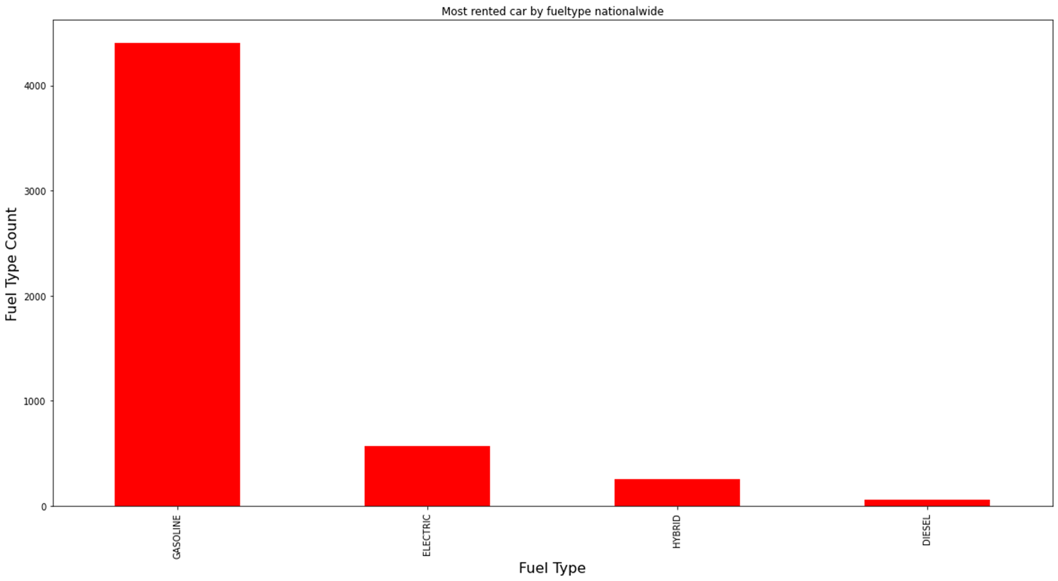
Rented vehicle by fuel type

Slide 6
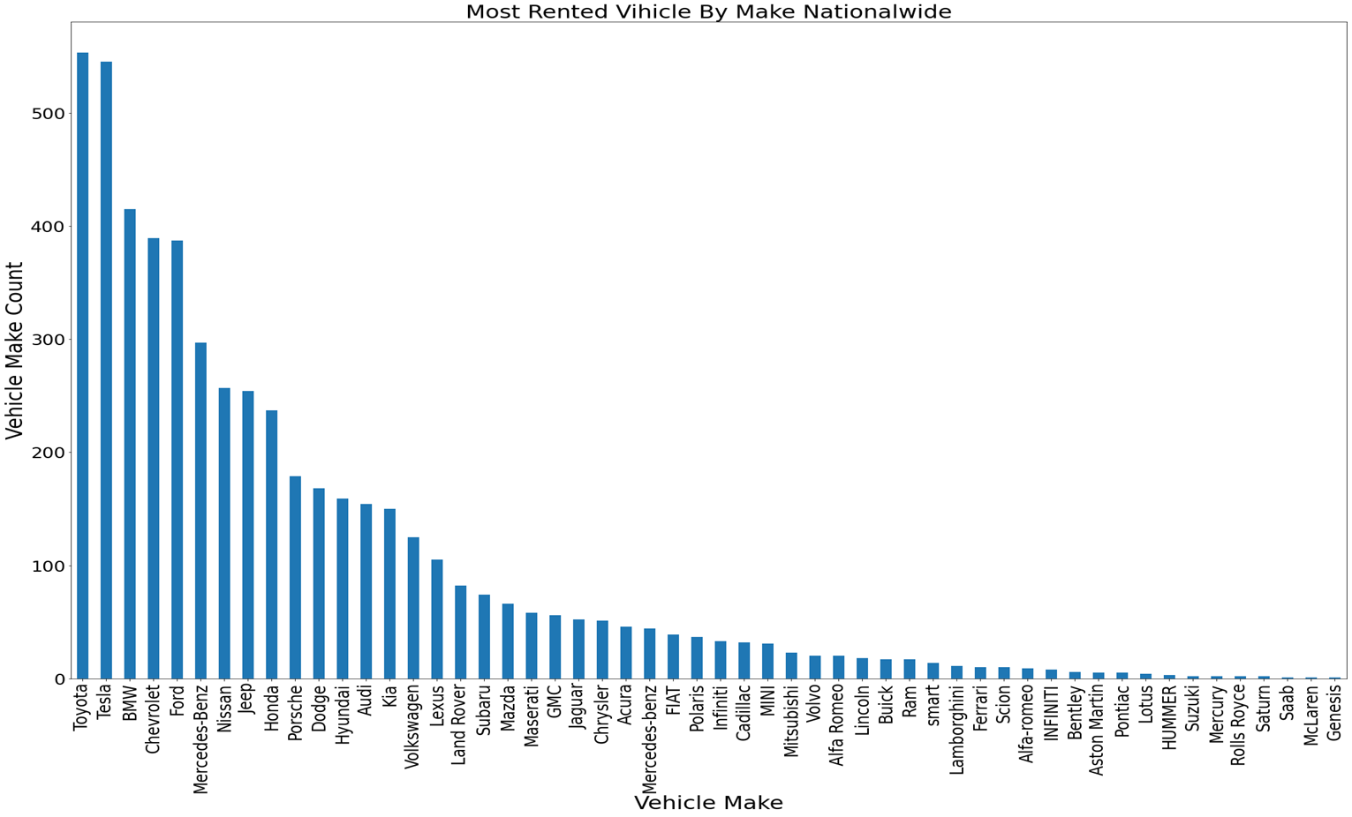
The rented vehicle by make

Slide 7
Explanation to rented vehicle by make and fuel type
From the plots, we find the frequency of the most rented fuel type. For Example: Gas, Electric, Hybrid and diesel. What we identified in that gasoline vehicles are the most rented.
Electric does take second place, giving us insight as to how people are starting to rent electric vehicles.
Also, we noticed that diesel was one of the least rented. We attribute this to the cost of diesel fuel and the possible low inventory of diesel ran engines at the rental companies ( to be further looked into).

Slide 8
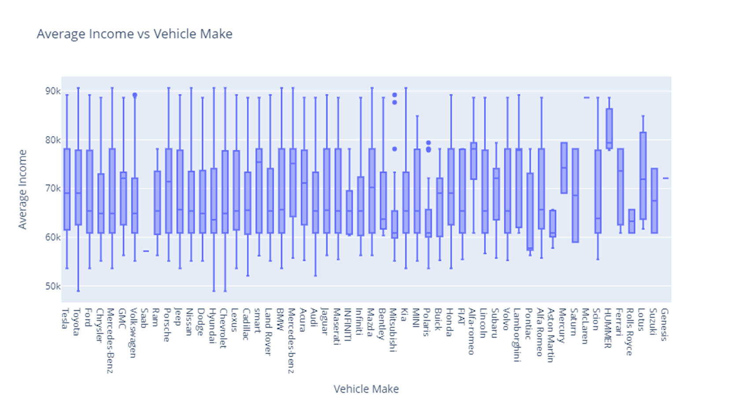

Slide 9
Average income by vehicle make
We looked at the average income vs vehicle make using boxplots.
This was a good visualization to use since it incorporates the maximum and minimum average income as well as as median for more reference.
Results found that low income and high income earners do not only pick high class make cars.
Further analysis that can be looked at: outlier detection, categorize the vehicle makes that do not fit in.

Slide 10
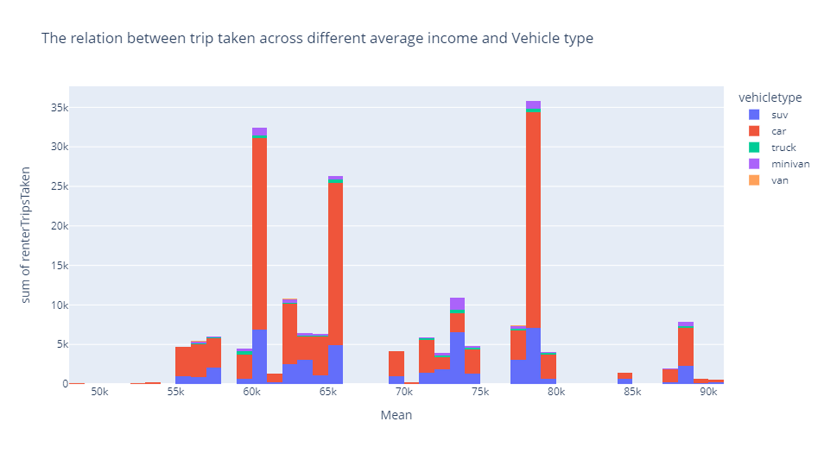
Here we did visualization that would connect our variables, except this time we included the average income. Now, we are looking to establish a base to see if there is a connection between what car are selected for rental and the average household income.

Slide 11
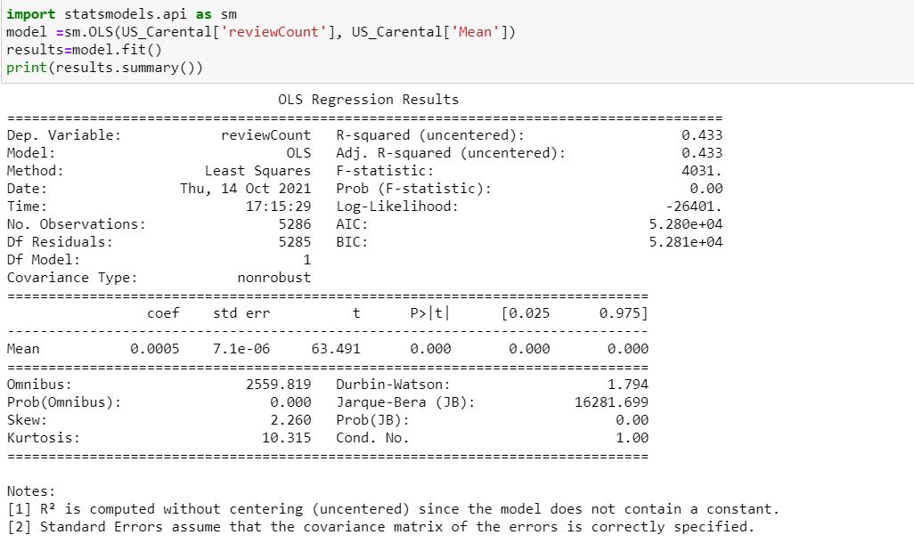
Regression test
If you look at the Renter trips(uncentered) taken and Mean: we have identified that our findings are statistically significant coming in at 0.00 , and therefore, we reject the Null hypothesis. Notice the word (Uncentered). In this case we did not add the constant on purpose to see.

Slide 12
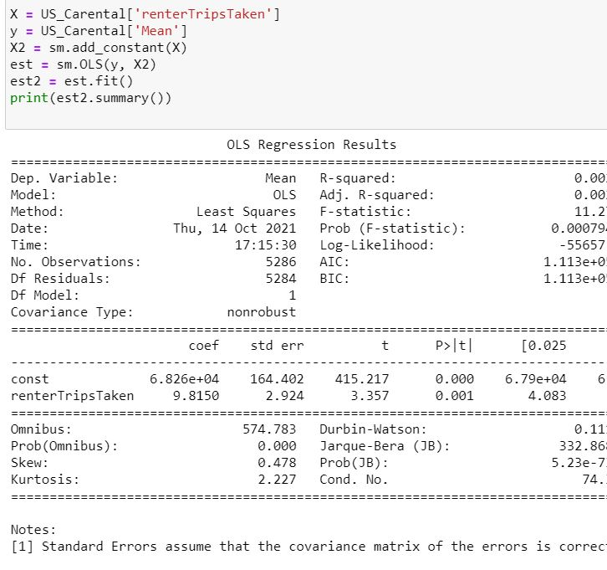
Regression test using constant
In the review count our R-squared was 0.443 with indicated that our data fits the regression line pretty well. In the Final Renters trips taken you can see that R- squared was adjusted and that we added a constant which gave us a P-value of 0.001. which supports our original hypothesis and rejects the Null hypothesis. We used Ttest to find the Pvalue which was also came out to 0.0. We used the regression results as our focus instead.

Slide 13
The End.
Thank you for your Time.

